Slide 1
Operating System
Lecture #5
Process Management

Slide 2
Objectives
Concept of Process.
Operations on Processes
Process control block.

Slide 3
Process
A process is an activity of executing a program. Basically, it is a program under execution.
Every process needs certain resources to complete its task.
The execution of a process is a complex activity. It involves various operations.:
Creation.
Schedule.
Premption
Blocking
Termination

Slide 4
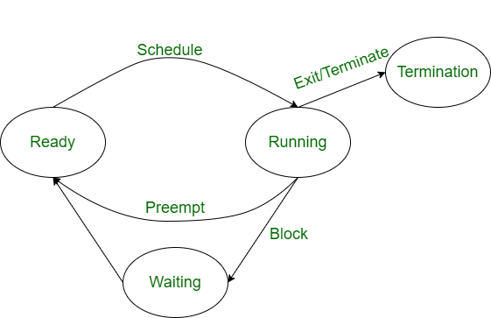
Operations on Processes

Slide 5
Creation
This is the initial step of process execution activity. Process creation means the construction of a new process for the execution. This might be performed by system, user or old process itself. There are several events that leads to the process creation. Some of the such events are following:
When we start the computer, system creates several background processes.
A user may request to create a new process.
A process can create a new process itself while executing.
Batch system takes initiation of a batch job.

Slide 6
Scheduling/Dispatching
The event or activity in which the state of the process is changed from ready to running.
It means the operating system puts the process from ready state into the running state.
Dispatching is done by operating system when the resources are free or the process has higher priority than the ongoing process.

Slide 7
Blocking
When a process invokes an input-output system call that blocks the process and operating system put in block mode.
Block mode is basically a mode where process waits for input-output. Hence on the demand of process itself, operating system blocks the process and dispatches another process to the processor.
Hence, in process blocking operation, the operating system puts the process in ‘waiting’ state.

Slide 8
Preemption
When a timeout occurs that means the process hadn’t been terminated in the allotted time interval and next process is ready to execute, then the operating system preempts the process.
This operation is only valid where CPU scheduling supports preemption. Basically this happens in priority scheduling where on the incoming of high priority process the ongoing process is preempted. Hence, in process preemption operation, the operating system puts the process in ‘ready’ state.

Slide 9
Termination
Process termination is the activity of ending the process. In other words, process termination is the relaxation of computer resources taken by the process for the execution.
Like creation, in termination also there may be several events that may lead to the process termination.
Process completes its execution fully and it indicates to the OS that it has finished.
Operating system itself terminates the process due to service errors.
There may be problem in hardware that terminates the process.
One process can be terminated by another process.

Slide 10
Process States
A process, from its creation to completion goes through different states. Generally, a process may be present in one of the 5 states during its execution:
New
Ready
Block or waiting
Running
Terminated

Slide 11
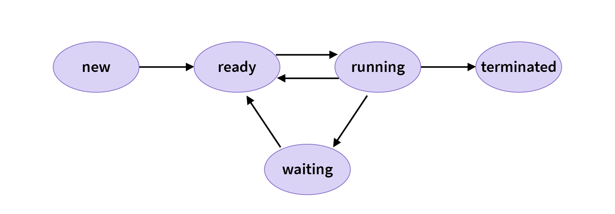
Process States

Slide 12
Process States
New: This state contains the processes which are ready to be loaded by the operating system into the main memory.
Ready: This state contains the process which is both ready to be executed and is currently in the main memory of the system. The operating system brings the processes from secondary memory(hard disk) to main memory(RAM). As these processes are present in the main memory and are waiting to be assigned to the CPU, the state of these processes is known as Ready state.

Slide 13
Process States
Running: This state contains the processes which are currently executed by the CPU in our system. If there is a total x CPU in our system, then a maximum number of running processes for a particular time is also x.
Block or wait: A process from its running state may transition to a block or wait for state depending on the scheduling algorithm or because of the internal behavior of the process (process explicitly wants to wait).
Termination: A process that completes its execution comes to its termination state. All the contents of that process(Process control block) will also be deleted by the operating system.

Slide 14
Process Control Block
Process Control Block is a data structure that contains information of the process related to it. The process control block is also known as a task control block, entry of the process table, etc.
It is very important for process management as the data structuring for processes is done in terms of the PCB. It also defines the current state of the operating system.
It’s a repository of information associated with a specific process.
PCBs are stored in specially reserved memory for the operating system known as kernel space.

Slide 15
Process Control Block
The role of the process control block arises as an identification card for each process. The Operating System doesn't know which process is which, until Operating System refers through the PCB of every process.
For Example:, there are MS word processes, pdf processes, printing processes, and many background processes are running currently on the CPU. How will OS identify and manage each process without knowing the identity of each process?
So, here PCB comes into play as a data structure to store information about each process.
Therefore, whenever a user triggers a process (like print command), a process control block (PCB) is created for that process in the operating system which is used by the operating system to execute and manage the processes when the operating system is free.

Slide 16
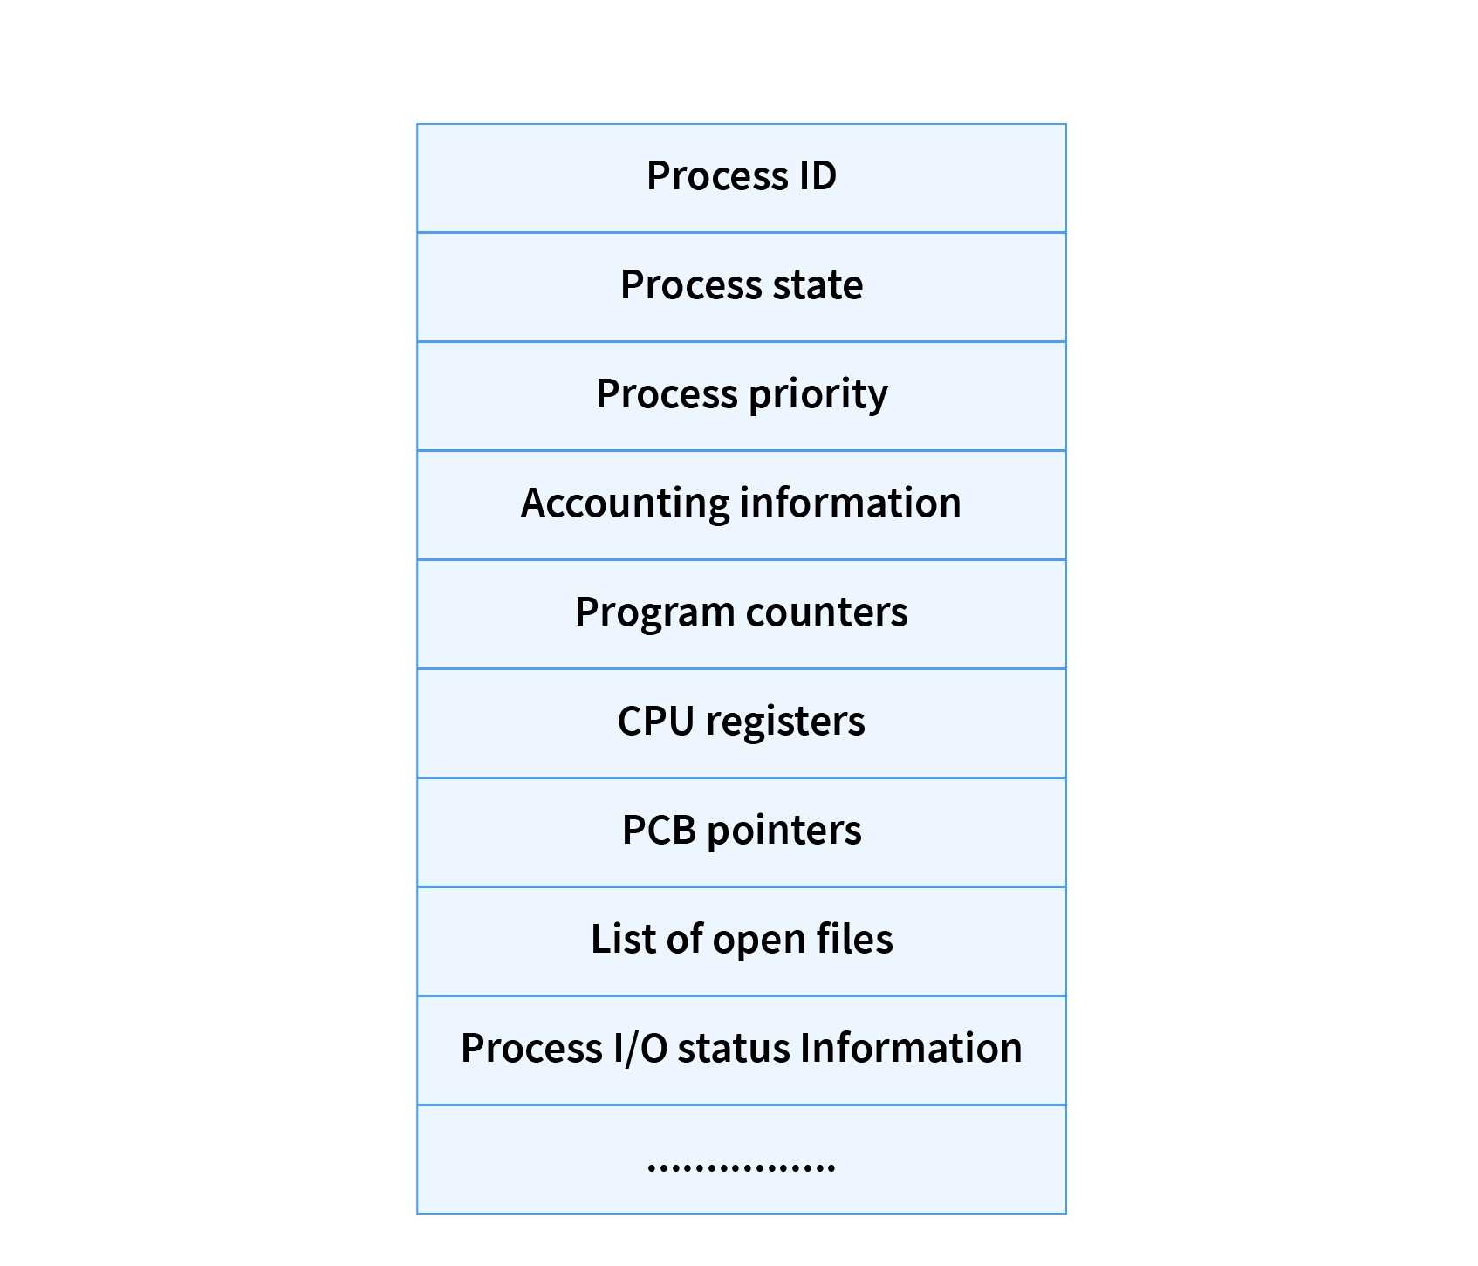
Process Control Block

Slide 17
Process Control Block
Process State
This specifies the process state i.e. new, ready, running, waiting or terminated.
Process ID
This shows the number of the particular process.
Program Counter
This contains the address of the next instruction that needs to be executed in the process.
Registers
This specifies the registers that are used by the process. They may include accumulators, index registers, stack pointers, general purpose registers etc.

Slide 18
Process Control Block
List of Open Files
These are the different files that are associated with the process
CPU Scheduling Information
The process priority, pointers to scheduling queues etc. is the CPU scheduling information that is contained in the PCB. This may also include any other scheduling parameters.
Memory Management Information
The memory management information includes the page tables or the segment tables depending on the memory system used. It also contains the value of the base registers, limit registers etc.

Slide 19
Process Control Block
I/O Status Information
This information includes the list of I/O devices used by the process, the list of files etc.
Accounting information
The time limits, account numbers, amount of CPU used, process numbers etc. are all a part of the PCB accounting information.
Location of the Process Control Block
The process control block is kept in a memory area that is protected from the normal user access. This is done because it contains important process information. Some of the operating systems place the PCB at the beginning of the kernel stack for the process as it is a safe location.

Slide 20
Any Query??

